Slide 1

AI-Powered Dyslexia Reading Assistant
Making learning inclusive, fun, and accessible.

Slide 2
Team & Title
AI-Powered Dyslexia Reading Assistant
Team Name: Shiro Review
Participants: 3
Making learning inclusive, fun, and accessible.

Slide 3
Problem Statement
Dyslexia affects reading, writing, and spelling.
Learners confuse letters (b/d, p/q), struggle with comprehension.
Existing tools: English-only, online-only, boring.
Millions of learners in India and Global South lack access.
👉 Without help, dyslexic learners face educational inequality.

Slide 4


Our Solution
We propose an AI-powered reading assistant that:
Converts text into dyslexia-friendly format.
Provides speech-enabled reading support.
Uses gamification to make learning fun.
Accessible for children aged 3–13.

Slide 5



Core Pillars
Accessibility
AI Assistance
Gamification
Fonts, spacing, background colors.
Simplify difficult words, read aloud.
Quizzes, badges, streaks.

Slide 6

Key Features - Accessibility
✅ OpenDyslexic fonts
✅ Adjustable spacing & background colors
✅ Text-to-Speech (English + Hindi)

Slide 7
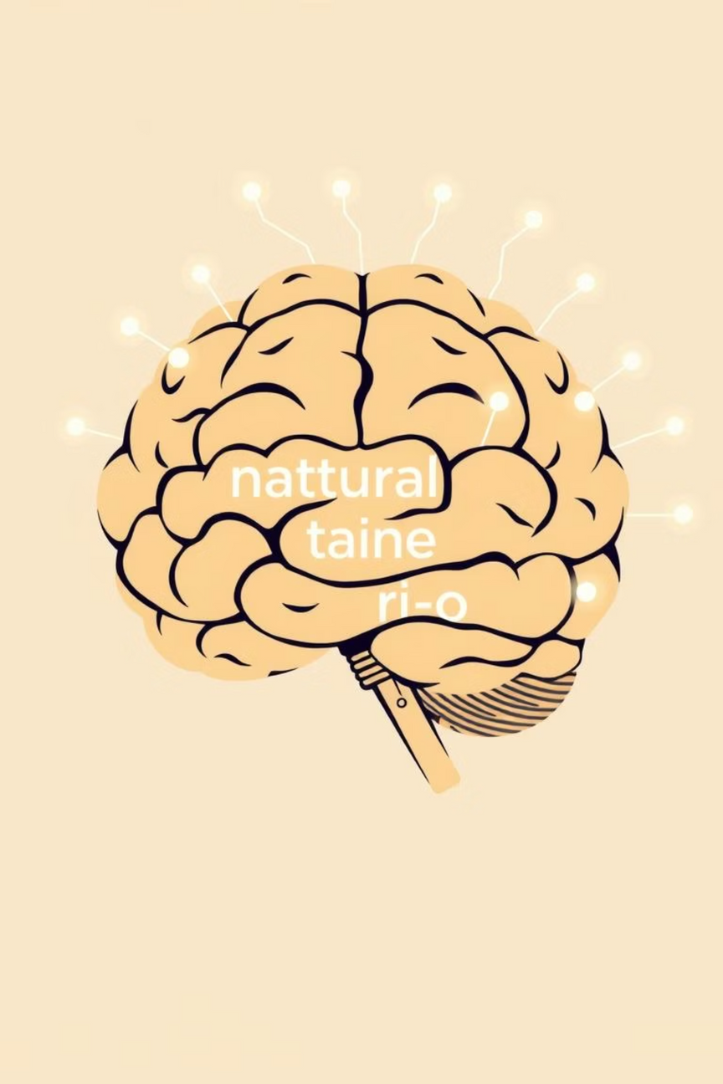
Key Features - AI Intelligence
✅ NLP detects difficult words
✅ Suggests simpler synonyms
✅ Summarizes complex passages (future upgrade)

Slide 8

Key Features - Engagement
✅ Auto-generated quizzes from reading material
✅ Rewards: streaks, badges, progress tracking
✅ Builds confidence & makes reading enjoyable

Slide 9
Real Life Sources
🔹 According to the Yale Center for Dyslexia & Creativity, dyslexia affects 1 in 5 children.
🔹 The British Dyslexia Association states early intervention improves outcomes.
🔹 In India, over 35 million children are estimated to have dyslexia, but awareness and tools are limited.
👉 Our solution bridges this accessibility gap.

Slide 10
Technical Workflow & MVP
01
02
Input text/file upload → preprocessing
Dyslexia-friendly conversion (fonts, spacing)
03
04
AI detects/simplifies difficult words
Text-to-Speech (English/Hindi)
05
06
Auto-generate quizzes
Progress tracking & badges
Hackathon MVP (24-36 Hours): Dyslexia display, AI simplification, TTS, Simple quiz.

